Slide 1

UOW ECON251
July 2026 Semester
Group Assignment

Slide 2
📊 Data Research Project: FDI, Structural Transformation, and the China Dynamic in Emerging Asia
Task: Group Research Project, Data Presentation, and PowerPoint Video Recording
Weight: [e.g. 30% of total grade]
Duration: 2 Weeks in tutorial 3 and 4
Deadline : 10th August 2025, 2359hrs (SG Time)
Submission Format: A recorded 10 - 15-minute video presentation (PowerPoint slideshow in MP4 video) + Excel appendix file.
Group Size: 3–4 students per group of same tutorial group

Slide 3
🎯 Project Overview & Objective
As Emerging Asian economies navigate shifting global supply chains, Foreign Direct Investment (FDI) remains a pivotal driver of structural change.
However, the rapid economic evolution of China presents a dual reality: China is simultaneously a massive investor, a vital trade partner, and a fierce competitor for global manufacturing share.
Your group will select one emerging Asia economy and conduct an empirical analysis over a 30 – 50 period from key data sites (WDI, UNCTAD)
You will evaluate how FDI has shaped the country’s industrialization, model the macroeconomic factors driving these inflows, and project the future of this economy through its complex relationship with China.

Slide 4

Choice of Emerging Asia Economies
India
Indonesia
Thailand
Vietnam

Slide 5
📋 Key Research Tasks & Deliverables
Your presentation must explicitly display and interpret data covering the following four pillars:
Pillar 1: FDI and Evidence of Industrialization
Pillar 2: The Inward FDI Network
Pillar 3: Drivers of FDI Inflows
Pillar 4: The China Dynamic (Collaboration vs. Competition)
Deliverables
Minimum 6 charts
1 regression
Data Source : World Bank, UNCTAD
Details given in the following

Slide 6
📋 Key Research Tasks & Deliverables
Your presentation must explicitly display and interpret data covering the following four pillars:
PILLAR 1: FDI AND EVIDENCE OF INDUSTRIALIZATION
Analyze the macroeconomic impact of foreign capital on your host country using data from the World Bank (WDI) and UNCTAD. You must feature three distinct chart types in this section:
Chart 1 : Growth & Capital (Line Chart): Long-term trends showing Real GDP growth rates and FDI net inflows over time to track macroeconomic cycles.
Chart 2 : Structural Shift (Stacked Column Chart): Visual evidence of industrialization over time (e.g., a 100% stacked column chart tracking the changing employment shares across Agriculture, Industry, and Services).
Chart 3: Labor Productivity Link (Scatter Plot): Plot a scatter plot mapping FDI Net Inflows (% of GDP) on the X-axis against Labor Productivity (GDP per person employed) on the Y-axis.
For Chart 1 and 3, please ensure there is the use and discussion of the trend line

Slide 7
📋 Key Research Tasks & Deliverables
PILLAR 2: THE INWARD FDI NETWORK
Chart 4: Source Country Mix (Stacked Bar Chart): Plot a stacked bar chart over time identifying the top 6 nations bringing FDI into your host country.
Chart 5 : Bilateral Focus: Identify the single largest source country from your chart. Plot using line chart to analyze the long-term trendlines of both trade volumes (export and import) and net FDI inflows from this partner.
Based on these trajectories, project their future level of economic cooperation—will their interdependence strengthen, or are they hitting a structural ceiling?

Slide 8
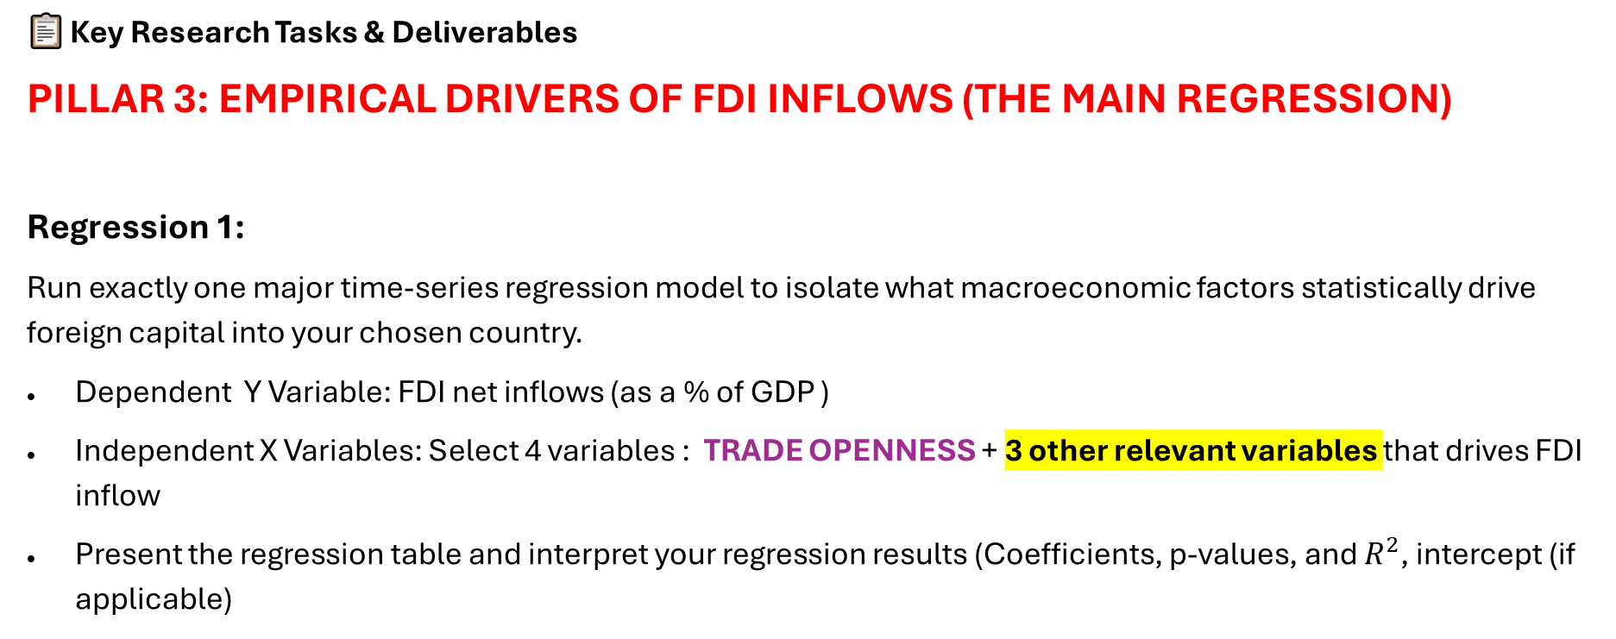
📋 Key Research Tasks & Deliverables
PILLAR 3: EMPIRICAL DRIVERS OF FDI INFLOWS (THE MAIN REGRESSION)
Regression 1:
Run exactly one major time-series regression model to isolate what macroeconomic factors statistically drive foreign capital into your chosen country.
Dependent Y Variable: FDI net inflows (as a % of GDP )
Independent X Variables: Select 4 variables : TRADE OPENNESS + 3 other relevant variables that drives FDI inflow
Present the regression table and interpret your regression results (Coefficients, p-values, and $R^{2}$, intercept (if applicable)

Slide 9
📋 Key Research Tasks & Deliverables
PILLAR 4: THE CHINA DYNAMIC (COLLABORATION VS. COMPETITION)
Evaluate the economic dependency and strategic future of your host country relative to China using bilateral trade and investment data.
Chart 6: Trade & Pacts (Line Chart): Plot the growth rate of bilateral trade with China.
In your chart, note relevant periods where key structural breaks when regional trade agreements (e.g., RCEP, ASEAN-China FTA) were implemented.

Slide 10
📋 Key Research Tasks & Deliverables
PILLAR 4: THE CHINA DYNAMIC (COLLABORATION VS. COMPETITION)
Evaluate the economic dependency and strategic future of your host country relative to China using bilateral trade and investment data.
Mini Research and discussion :
The Strategic Verdict: Conclude with a data-backed argument:
Is your host country’s future one of collaboration (acting as a vital cog in China's regional value chain) or competition (actively capturing manufacturing share as firms adopt "China+1" strategies)?

Slide 11

Guidelines on presentation

Slide 12

🎬 Technical & Recording Instructions for Your PowerPoint Presentation
👤 1. Team Visibility Requirements
The 1-Minute Rule: Every single member of your group must appear on camera with their video turned on for at least 1 minute during the presentation (e.g., during their designated speaking part or a group introduction).
Rest of the Presentation: For the remaining duration of the video, you may turn your webcams off so the audience can focus entirely on your data charts and full-screen slides.
Equitable Contribution: Grading marks will account for equal distribution of speaking time. No single student should dominate the presentation.
This Photo by Unknown Author is licensed under CC BY-NC

Slide 13
🎬 Technical & Recording Instructions for Your PowerPoint Presentation
⏱️ 2. Strict 15-Minute Time Limit
The Grading Ceiling: Your recording must be a maximum of 15 minutes.
The Hard Cutoff: Any presentation content, analysis, or conclusions spoken beyond the 15:00 mark will be completely ignored and will not be graded.
Pacing Pro-Tip: Do not rush your delivery. Use the suggested slide blueprint to practice your transitions and ensure your team finishes comfortably between 14:00 and 15:00 minutes
This Photo by Unknown Author is licensed under CC BY-NC

Slide 14
🎥 3. Recording Mechanics in PowerPoint
Asynchronous Recording Workflow in PowerPoint
Record Separately, Combine Easily: Your group does not need to meet up or jump on a group call to record the video.
Instead, work on a single, master PowerPoint file.
Each member can record their own designated slide segments individually from their own computer when they are ready.
PowerPoint will automatically save your voice and video overlay directly onto those specific slides.
This Photo by Unknown Author is licensed under CC BY-NC

Slide 15
🎥 3. Asynchronous Recording Workflow in PowerPoint
How to Record Your Part: Open the master presentation, click on the slide you are responsible for, and go to Record > From Current Slide. Ensure your mic is unmuted and your webcam is turned on for your required 1-minute minimum segment.
Saving the Final File: Once everyone has finished recording their respective slides, the group leader just needs to open the master file, double-check that all audio/video tracks play smoothly, and export the entire deck as a single MP4 video file (File > Export > Create a Video).
Aspect Ratio & Layout: Keep your slide dimensions set to Widescreen (16:9). When positioning your charts, leave a little bit of empty space in the bottom-right corner of your slides so your recorded webcam bubble doesn't block any important data or axis labels!
Submission on Cloud Link : Upload your MP4 on the cloud ( Google drive, Dropbox, One drive); Remember to set the link sharing permissions to "Anyone with the link can view
This Photo by Unknown Author is licensed under CC BY-NC

Slide 16

⏱️ 10-to 15-Minute Slide Blueprint
Slide 1: Introduction & Core Thesis — 1 Minute
Slides 2–4: Industrialization, Sector Shifts & Productivity (Line, Stacked Column, and the FDI vs. Productivity Scatter Plot) — 4.5 Minutes
Slide 5: The FDI Origin Network (Stacked Bar Chart) — 2.5 Minutes
Slide 6: Main Regression Results (Single table interpretation focusing on coefficients, significance, and $R^{2}$) — 3 Minutes
Slides 7–8: The China Relationship & Strategic Outlook (Bilateral trade data, pacts, and definitive final verdict) — 4 Minutes
Note: We do not see the excel sheet, the table of figures. Do not spend time explaining the steps of how to plot the charts or run the regression. Focus on the interpretation
This Photo by Unknown Author is licensed under CC BY-NC

Slide 17

To Moodle with
One single submission
Submit the cloud link and the excel sheet containing all data , charts and regression results

Slide 18
Grading
2. Economic Data presentation
25M
3. Data analysis
35M
4. Group Presentation
15M
1. Data Collection and research efforts
25M
100 marks convert to 30% course assessment weightage

